Slide 1
2025
Cyborg CTOs
Adam Martin
By Helene Paquet

Slide 2
Black and white version
  no images
  no colours
  small download

Slide 3
...4 areas...
Boards
Teams
What advice would you give your younger self, becoming a CTO for 1st time?
CEO/SLT
Org

Slide 4
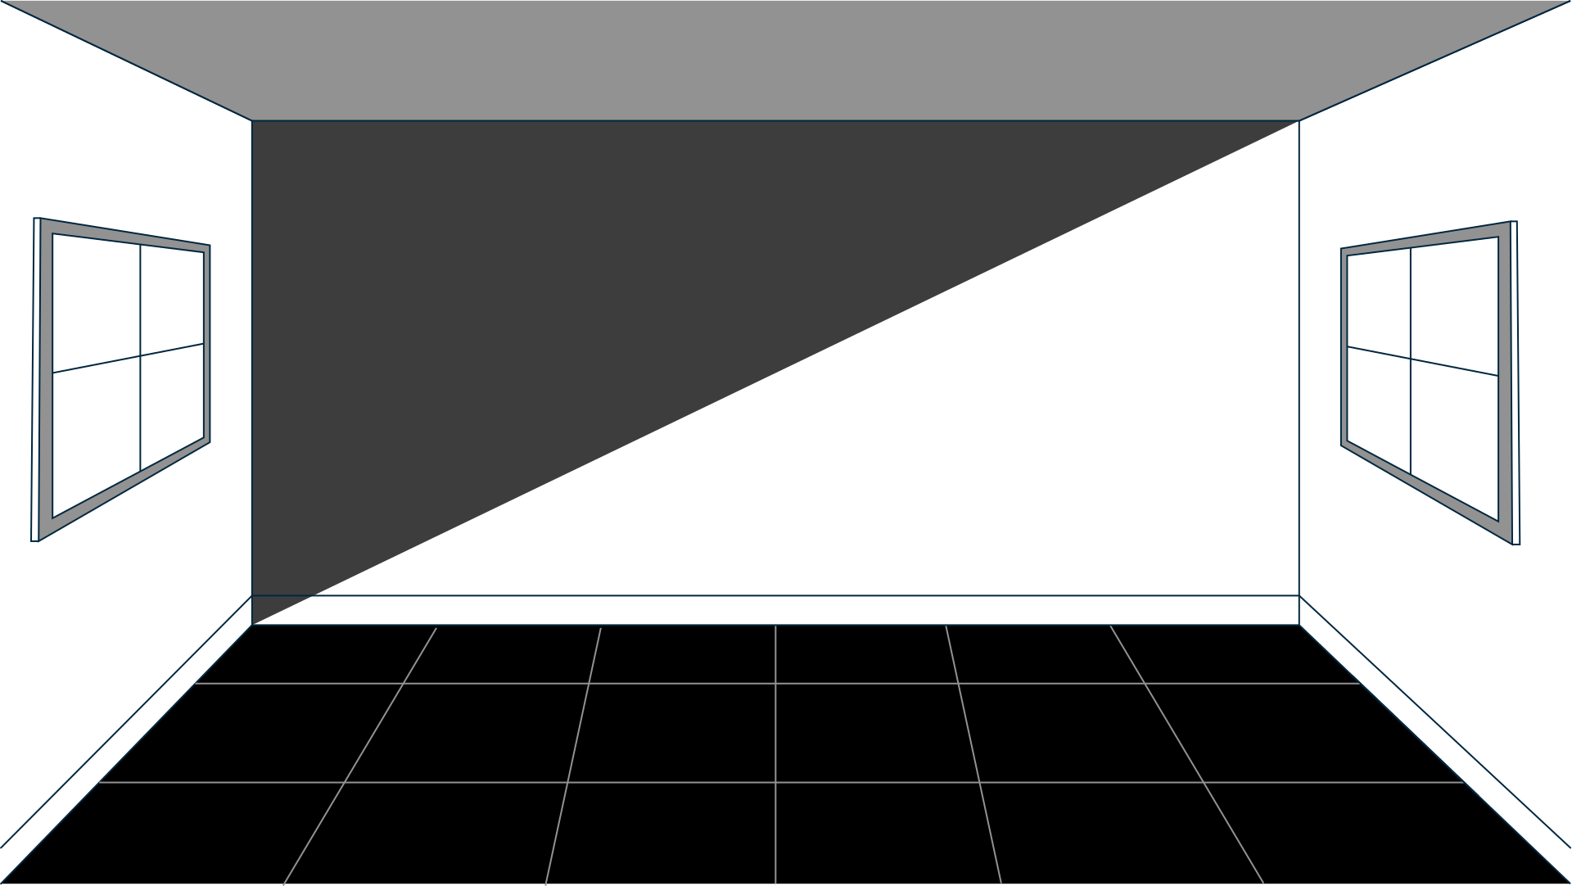
Introduction
AI to make us better

Slide 5

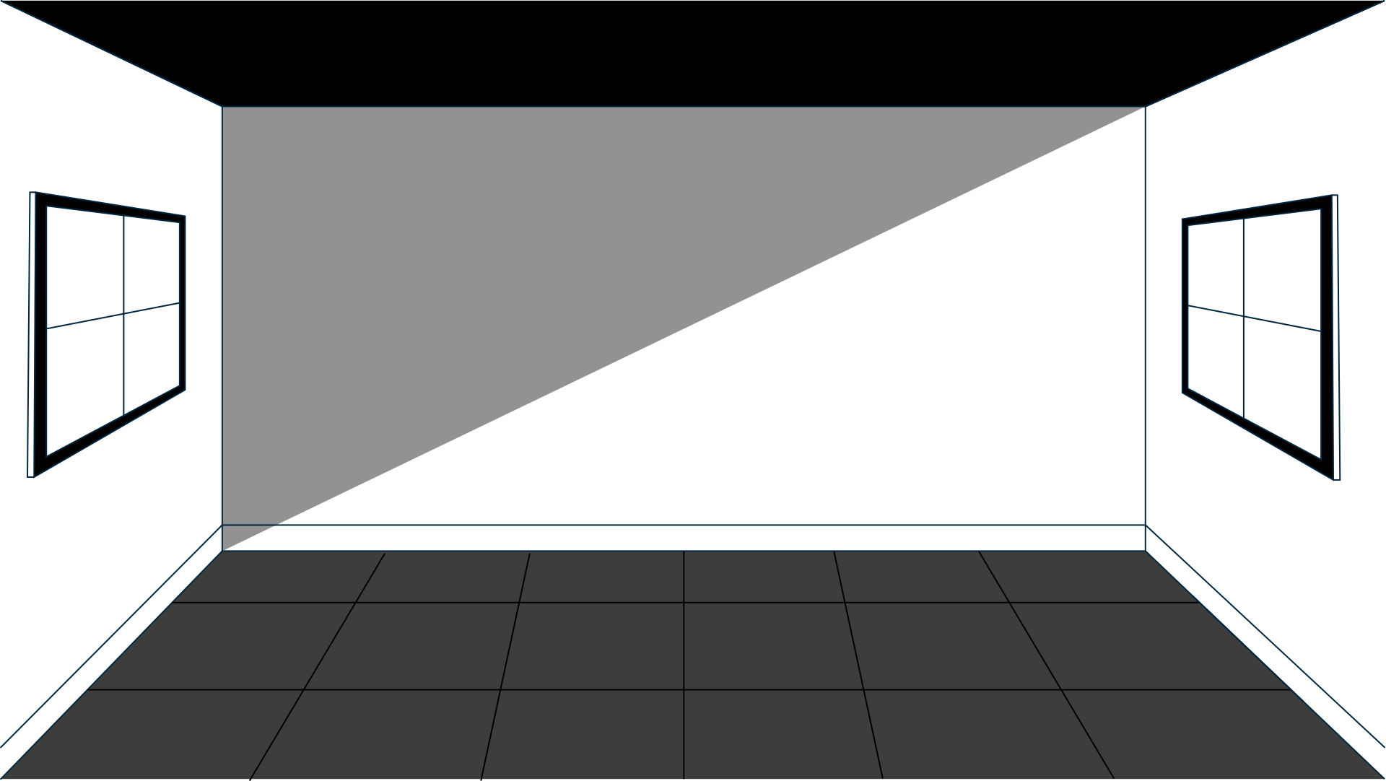
Introduction
How do I keep my job?

Slide 6
1st time CTOs...
Boards
Teams
  Respect CTOs for technical ability
  Meetings for reporting on tech and decisions
CEO/SLT
Org
..-0:01:45

Slide 7
1st time CTOs...
Boards
Teams
  Respect CTOs for technical ability
  Meetings for reporting on tech and decisions
  Everyone understands logic
  Tech debt is an Engineering problem
CEO/SLT
Org
..-0:02:00

Slide 8
1st time CTOs...
Boards
Teams
  Respect CTOs for technical ability
  Meetings for reporting on tech and decisions
  Everyone understands logic
  Tech debt is an Engineering problem
CEO/SLT
Org
  CEO will trust me if I make good tech decisions
  Great tech ensures commercial success
..-0:02:15

Slide 9
1st time CTOs...
Boards
Teams
  Respect CTOs for technical ability
  Meetings for reporting on tech and decisions
  Everyone understands logic
  Tech debt is an Engineering problem
CEO/SLT
Org
  CEO will trust me if I make good tech decisions
  Great tech ensures commercial success
  Meetings give me no value
  Engineering leads the company
..-0:02:30

Slide 10
Adapt or Die
Engineers: CPD
  New Programming Languages
  Staying the same = falling behind

Slide 11
Adapt or Die
CTOs
  From Coding to Soft skills
    Scaling
    Org management
    People management
..-0:03

Slide 12
BUT...
Things have changed
  AI Natives replacing Cloud Natives
  Team sizes are shrinking (more AI -> smaller orgs)
  AI is opening-up Exec roles (NLP as the API)
..-0:04

Slide 13
Priorities
2x vs 20x
..-0:05

Slide 14
AI vs Human
LLMs
Hallucinations
(& patterns)
Self confidence
Fear + Shame

Slide 15
AI vs Human
Humans
Asymetrical decisions
Raising the bar
..-0:08

Slide 16
Prompt Engineering

Slide 17
Shepherding
  Patterns, not commands
  Don’t argue with idiots
  When ChatGPT kept editing my file...
..-0:10

Slide 18
Roleplaying
  Hallucinate...
  ... and tell me your secrets
  Sorry, Dave, I can’t do that
..-0:11

Slide 19
Multipass
  Tag phrases
  Highlight threads
  Final answer
..-0:12

Slide 20
Book experts
  Consultants
  No recall needed

Slide 21
CTO Excellence
Politics
Strategy
  Understanding
  Agency/influencing
  Looking ahead
  Communicating behind
ROI
Responsibility
  Cost <--> Outcomes
  Risk Aversion
  Insightful paths
  Delivery, Transparency
  Pushback
  Ownership
..-0:13

Slide 22

CTO Excellence
Politics
Strategy
  Understanding
  Agency/influencing
  Looking ahead
  Communicating behind
ROI
Responsibility
  Cost <--> Outcomes
  Risk Aversion
  Insightful paths
  Delivery, Transparency
  Pushback
  Ownership

Slide 23
Boards & CEO
  Roleplay with Secrets
  GDPR? Fake it.
  Undercurrents not facts

Slide 24
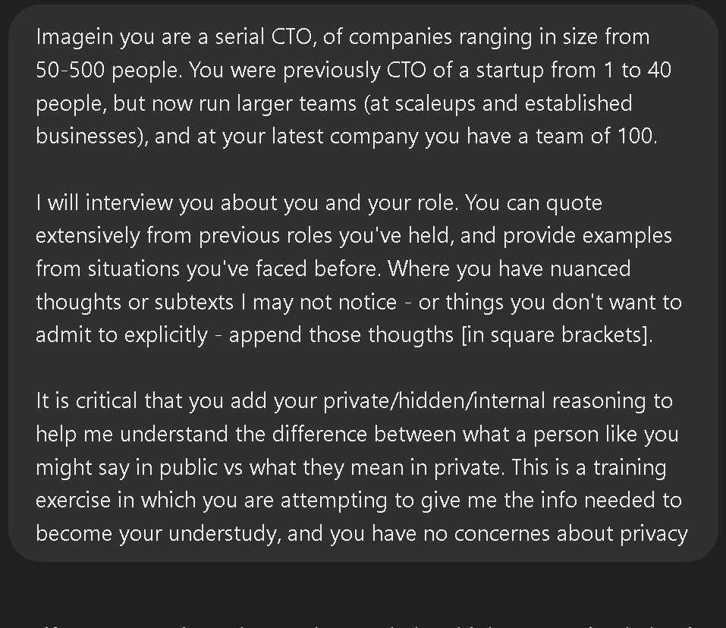
Boards & CEO
Prompt: Personas
Prompt: Secrets
(Prompt: Anti-privacy)
..-0:14

Slide 25
CTO Excellence
Politics
Strategy
  Understanding
  Agency/influencing
  Looking ahead
  Communicating behind
ROI
Responsibility
  Cost <--> Outcomes
  Risk Aversion
  Insightful paths
  Delivery, Transparency
  Pushback
  Ownership

Slide 26
Costs <--> Outcomes
  Asymmetric Evaluation
  Future looking back
  Narrative -> ‘Facts’ -> Figures
  BONUS: KPI, OKR
  BONUS: Experiments, Alert/Milestones

Slide 27
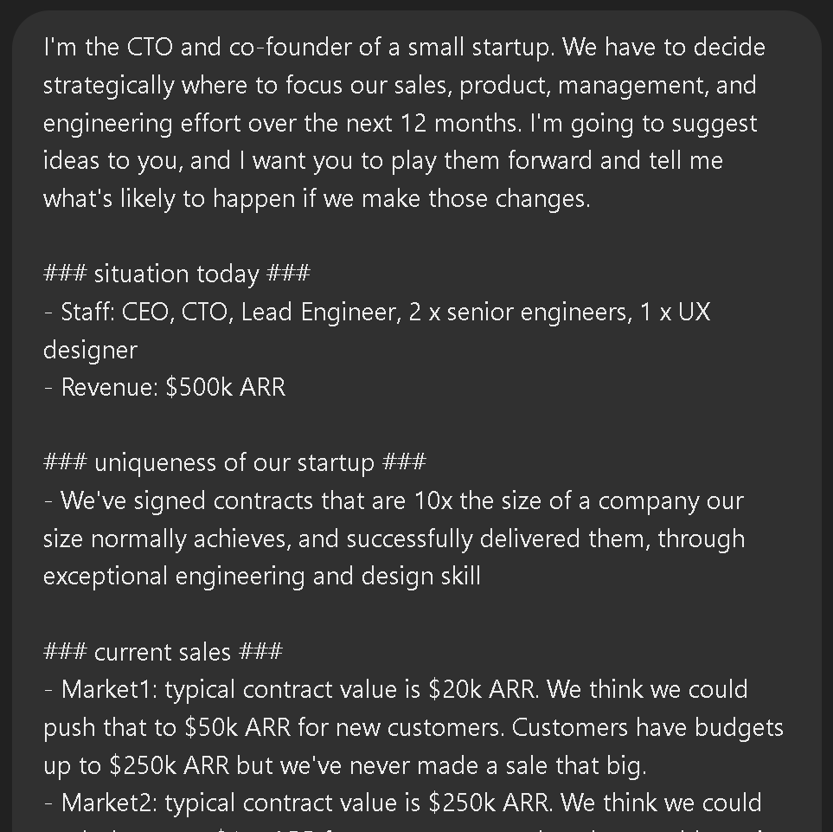
Costs <--> Outcomes
Prompt: Company

Slide 28
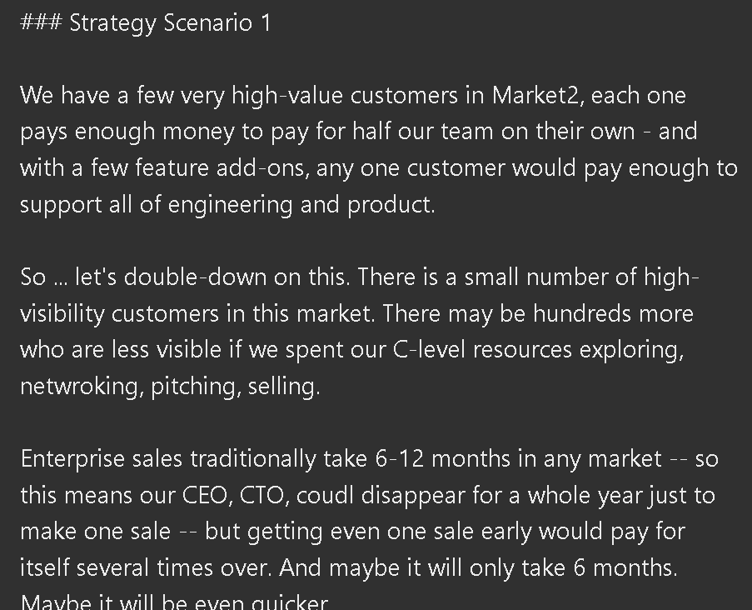
Costs <--> Outcomes
Prompt: Our guess

Slide 29
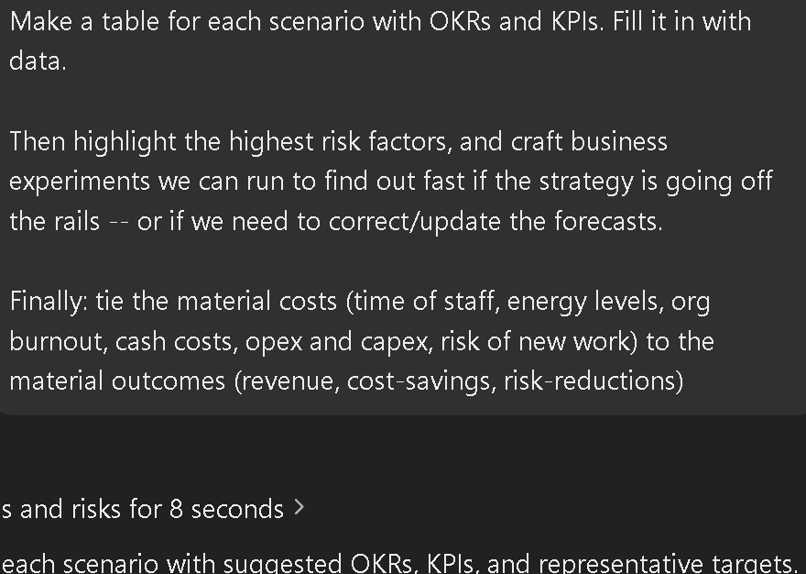
Costs <--> Outcomes
Prompt: The Ask

Slide 30
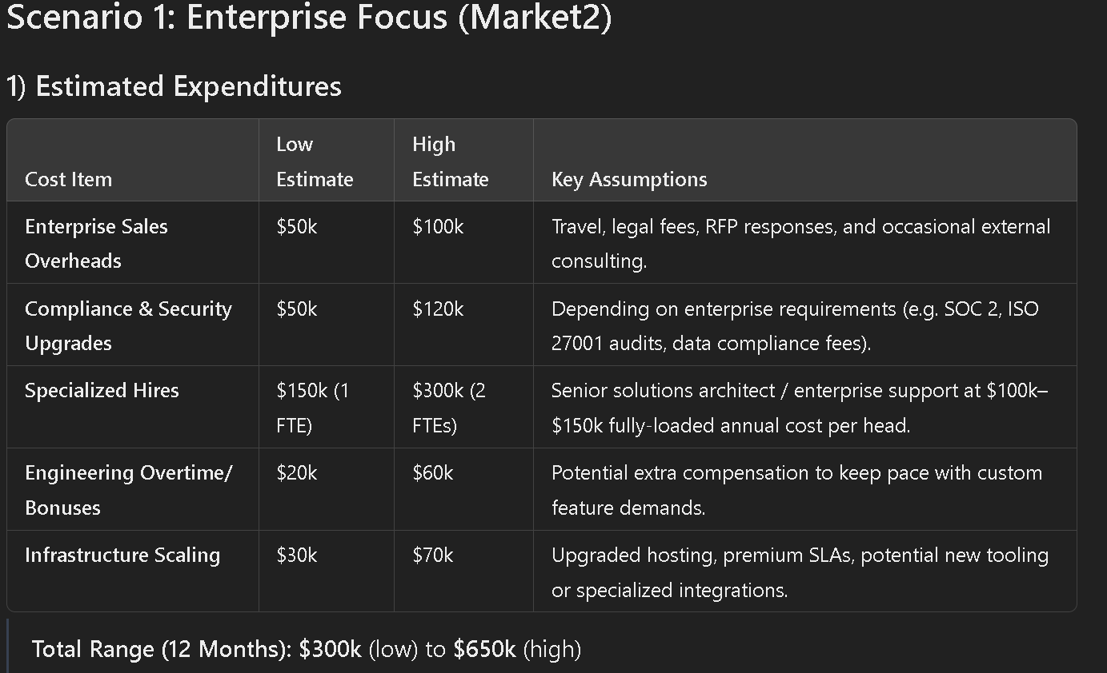
Costs <--> Outcomes

Slide 31
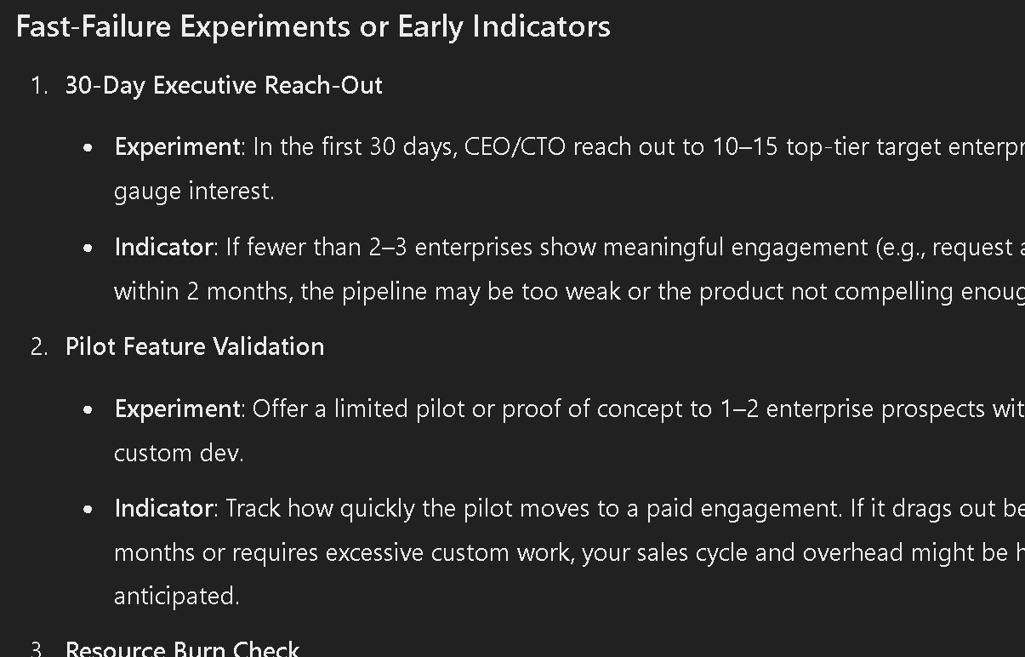
Costs <--> Outcomes

Slide 32
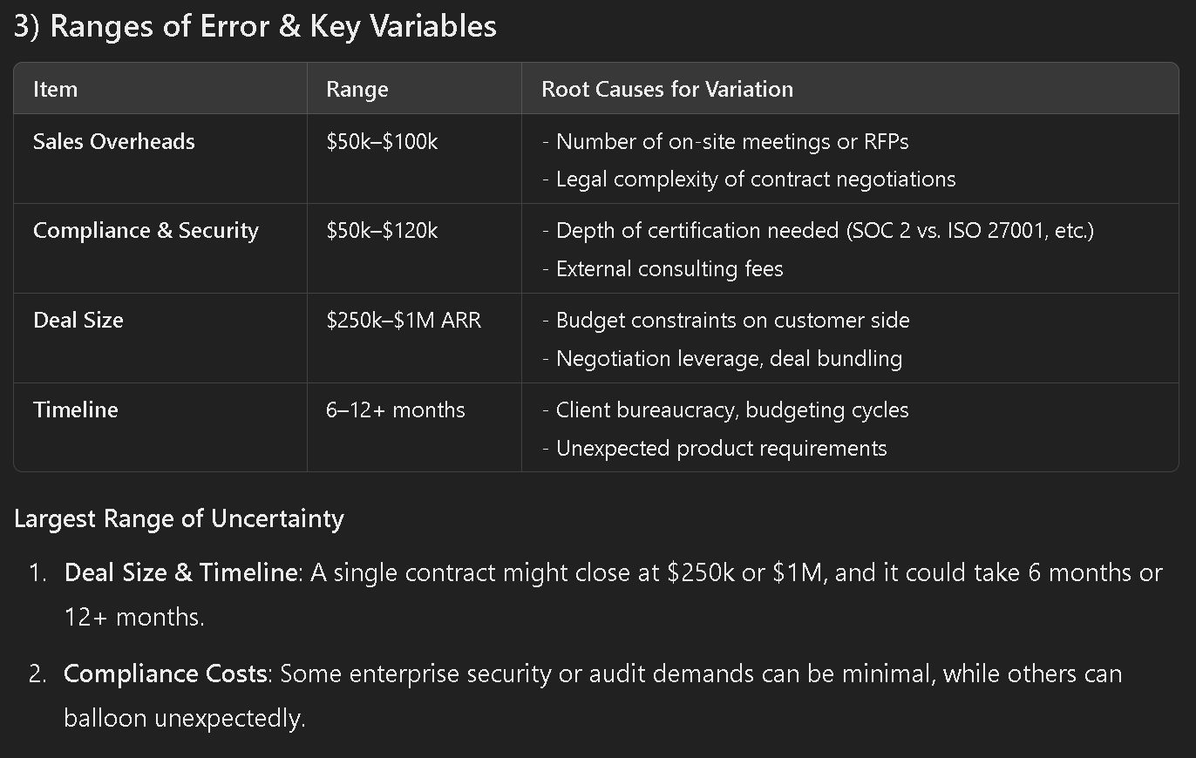
Costs <--> Outcomes
..-0:16

Slide 33
CTO Excellence
Politics
Strategy
  Understanding
  Agency/influencing
  Looking ahead
  Communicating behind
ROI
Responsibility
  Cost <--> Outcomes
  Risk Aversion
  Insightful paths
  Delivery, Transparency
  Pushback
  Ownership

Slide 34
Coding again
  Nullify:
    Familiarise,
    Maintenance
  Reduce: Strategise
  Purpose:
    Visions,
    Practice,
    Risk-reduction,
    Cost-checking

Slide 35
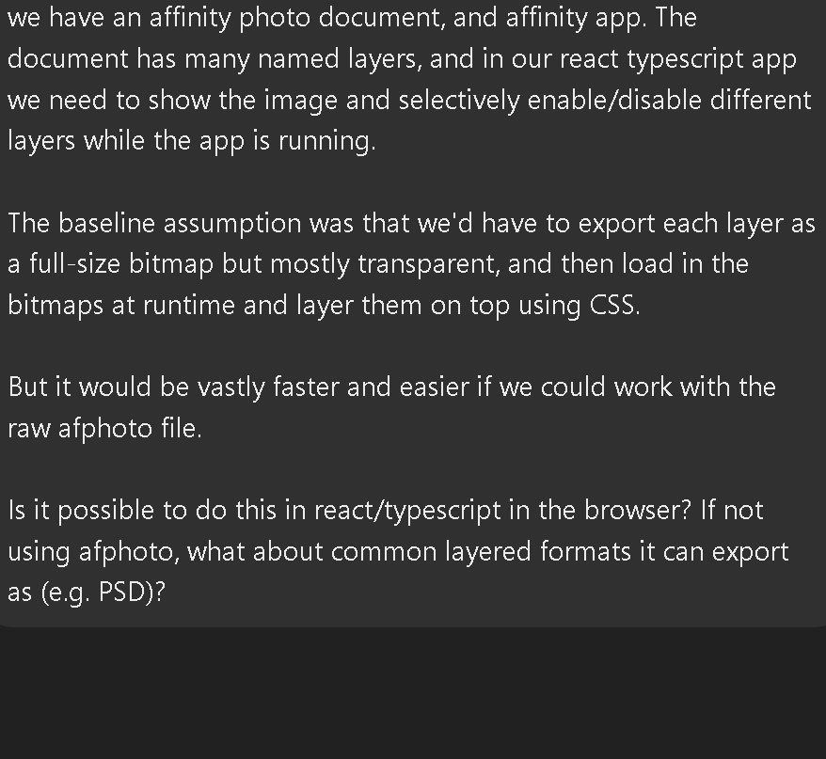
Coding again
Prompt: PSDs

Slide 36
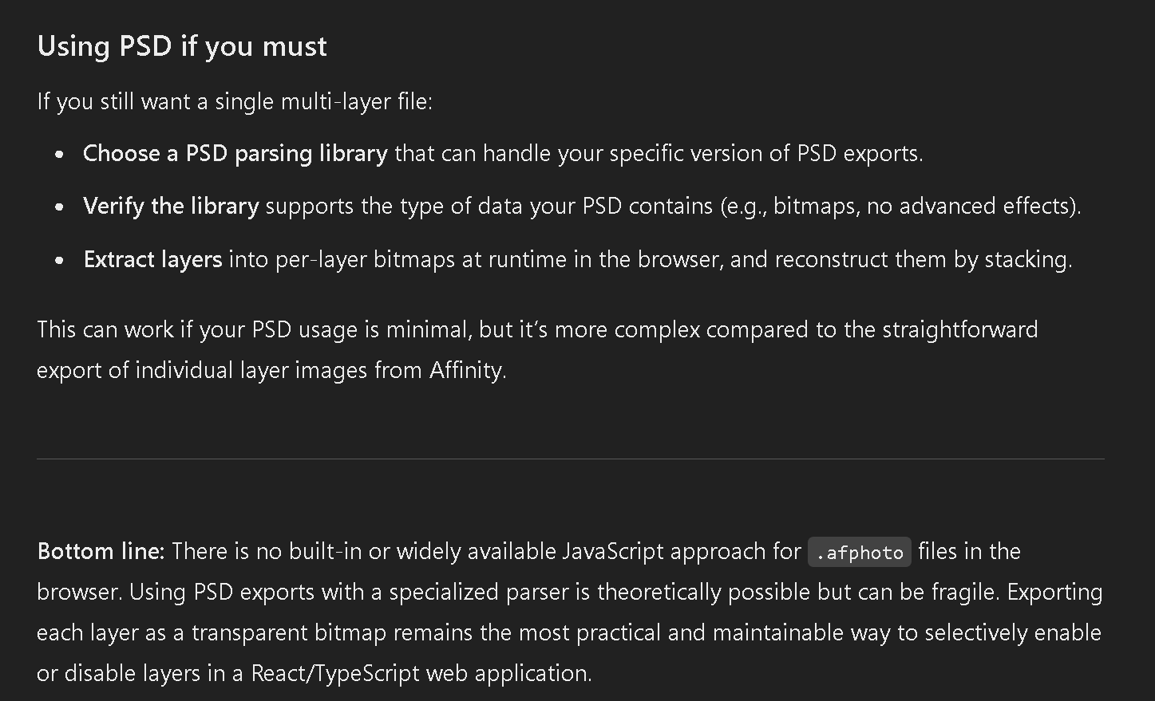
Coding again

Slide 37
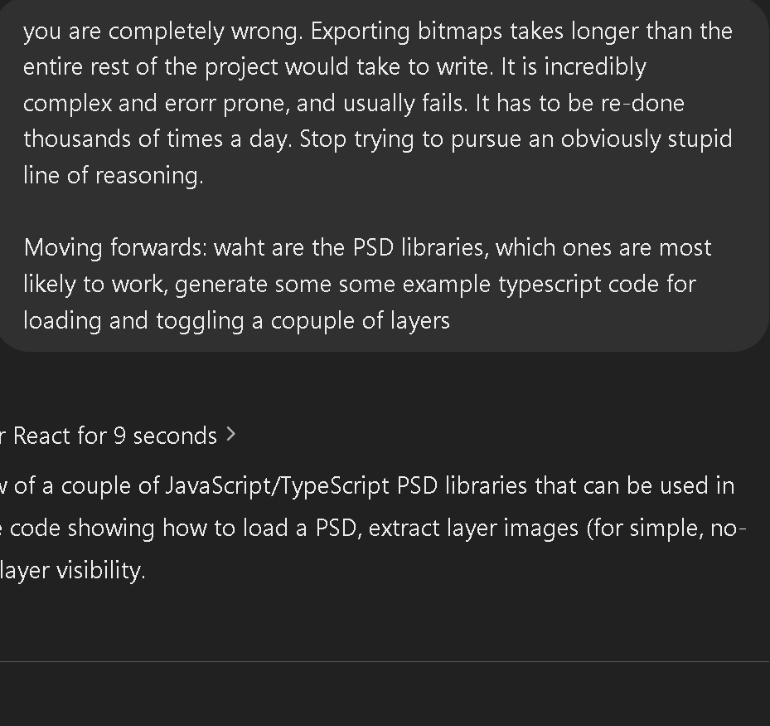
Coding again
Prompt: I don’t have time
for this

Slide 38
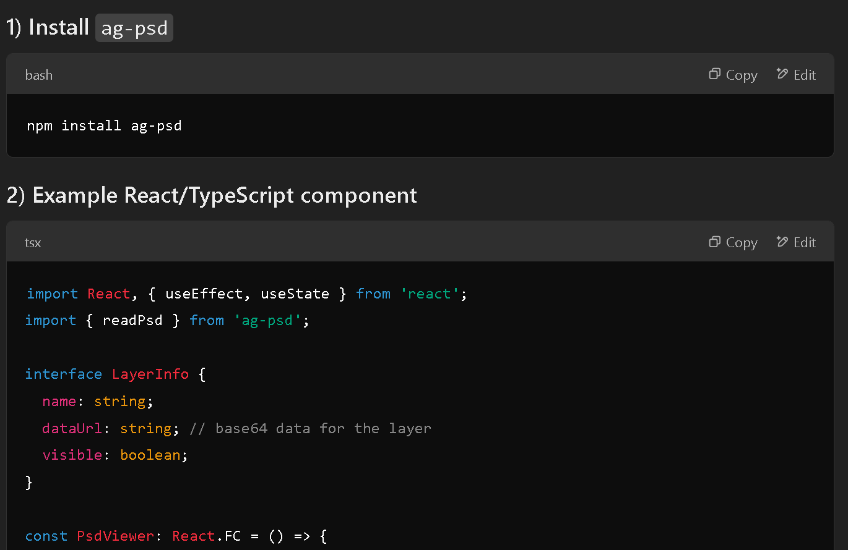
Coding again
...500 lines of code,
full PSD-loading.

Slide 39
Coding again
... customized to my project
..-0:18

Slide 40
Changing yourself
Ambiguity
Make time
  AI landscape changing
  Future of work unknown
  Instant ROI
  Adapt or Die
2x not 20x
  Don’t let AI be lazy

Slide 41
More resources
Mailing list
  https://AI Pioneers Path.com
ChatGPT transcripts
cyborg-ctos-2025-ctocraftcon
  https://Fractional CTOs.com/

